Slide 1
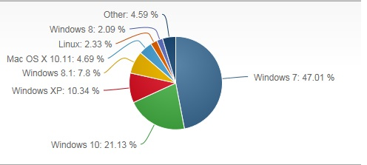
Percentage of Windows Users https://www.netmarketshare.com/operating-system-market-share.aspx?qprid=10&qpcustomd=0
2016-17
url:
url

